Slide 1





On the retrodiction of quantum states
Valerio Scarani

Slide 2

What is retrodiction
Test ϕ (known)
80%
SICK
POSITIVE
40%
Prior belief
Updated belief
20%
60%
HEALTHY
NEGATIVE
P(S|N) = P(N|S)P(S) / [P(N|S)P(S)+P(N|H)P(H)]

Slide 3
Seen in probability space
Prior belief
Updated belief
SICK
HEALTHY
ϕ
POSITIVE
NEGATIVE
And so:
The image domain of ϕ is smaller than the state space (simplex).
The specific outcome may be outside the image domain: even if the map is invertible, Bayesian retrodiction is not inversion.

Slide 4
Equivalent mixtures
…

Slide 5
Retrodiction
Initial belief
Z=+1
Updated belief
Bayes’ rule: certainty is immune to updates

Slide 6
Is this surprising?
NO! Everyone knows that retrodiction depends on your prior belief.
Still…
The belief on the system of interest is the same.
It’s the belief on the preparation that changes.
What we have seen is a feature of quantum inference, due to the existence of different equivalent preparations.
for prediction
In particular, members of the Church of the Larger Hilbert Space should never update their belief, because it is a state of maximal knowledge (pure state).

Slide 7
No analog in classical information
B=b₀
B=b₀

Slide 8
While we are here: Retrodiction as a linear map
B=b₀
r(b)
“Jeffrey’s update”
Stochastic vector: updated belief
Stochastic vector: evidence (hard or soft)
Stochastic matrix: retrodictive map (depends on the prior belief)

Slide 9
Quantum retrodiction (basic)
Example:
Pre-measurement
Evidence
Example: outcome of measurement
Prior belief
Updated belief
Petz recovery map
= retrodictive map (first attempt)

Slide 10
Why Petz? (1) A note on quantum Bayes’ rule(s)
There are many candidates for “quantum Bayes’ rule”
Related to “states-over-time”.
Petz is the only map that satisfies the axioms below [Buscemi, Parzygnat, Quantum 7, 1013 (2023)]:
Valid for all channels.
Recovers the prior if it was the true state.
It is the inverse for reversible maps.
Involution: the retrodiction of the retrodiction is the channel.
Composition: appending retrodictions
Tensoriality: retrodiction on composite systems.

Slide 11
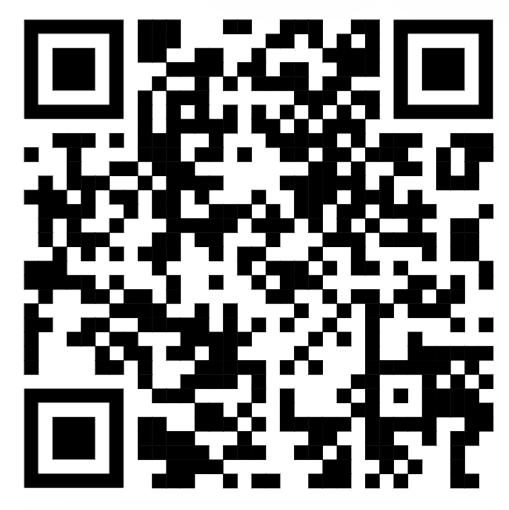
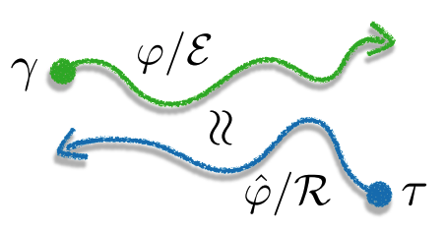
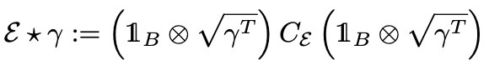
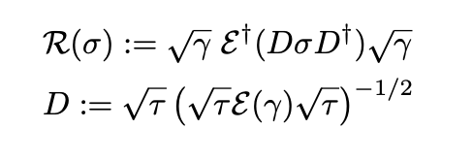
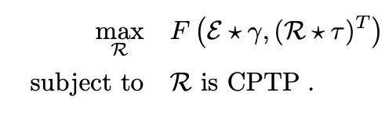
Why Petz? (2) Minimum change derivation
Find such that some distance between P_{F} and P_{R} is minimized.
Classical: for many distances,
Quantum: Bai, Buscemi, VS, arXiv:2410.00319
Petz if

Slide 12
Adding preparation
Preparation
&
Retrodictive map
Petz of for the joint prior Γ
Previous examples

Slide 13
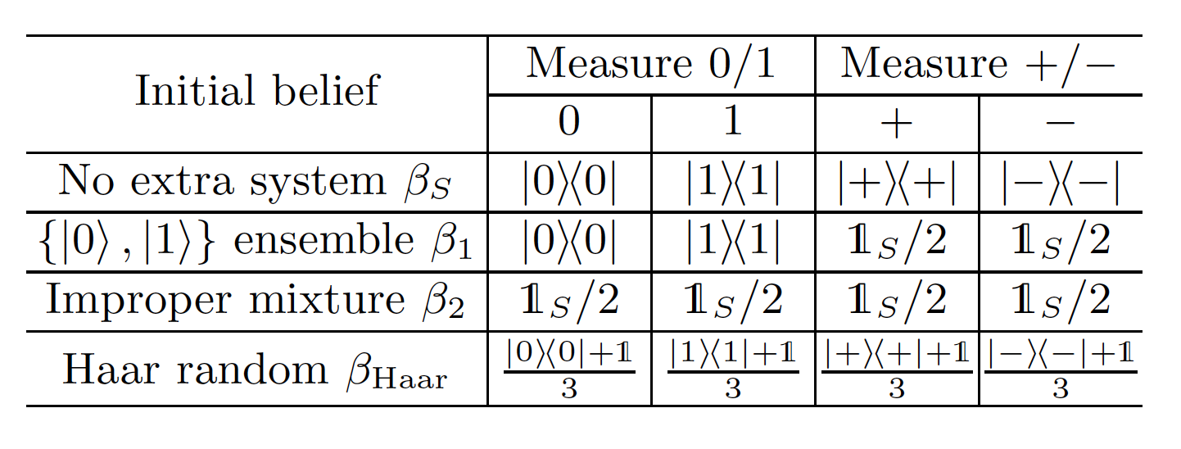
Back to the example
Initial belief
Updated belief
Just
Haar random preparation

Slide 14
Equivalent beliefs: a theorem
(generate the same retrodictive map)
if and only if the two
are equal.
Example: Haar random and 6-Pauli preparations:
Remark: the obvious necessary condition was not imposed from the start: it follows from the theorem.

Slide 15
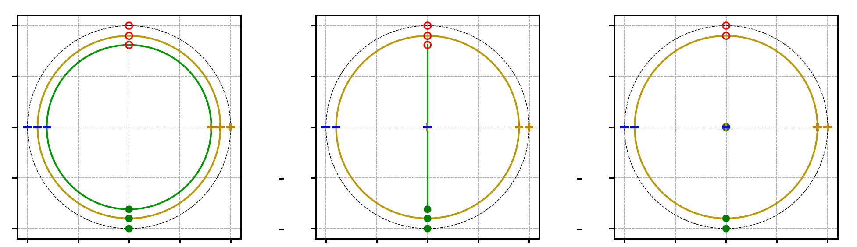
“It’s all useless, no measurement can distinguish those situations”
“It’s as useless as Bayes’ rule is useless” (F. Buscemi, private communication)
Beliefs have consequences!
Not for observations/predictions;
but for action.
Trying to recover a depolarizing channel. The true state is pure, the belief is
Just
Bloch sphere

Slide 16

Summary
A quantum belief should include the belief about the preparation, because some logical inference (here, retrodiction) depends on it.
We devised a retrodictive map that captures this, and a theorem on equivalence of beliefs.
Mingxuan Liu, Ge Bai, VS
arXiv:2502.10030

Slide 17
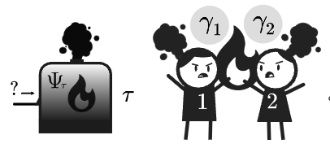
More Bayesian retrodiction in this conference
Poster by Minjeong Song:
Conditions of tabletop reversibility: when is reversing Lindbladian dynamics cost-free?
Talk by Clive Cenxin Aw:
Irreversibility as the dependence on Bayesian priors
This poster was yesterday, so you’ll have to retrodict the content based on this information ☺
(Or better: talk to Minjeong)
Friday 10:35
(But can talk to Clive earlier; see also arXiv:2503.12112 today)

Slide 18

Clive
Mingxuan
Minjeong

